Slide 1
Python backend developer
Presenteb by Swastik sompura

Slide 2
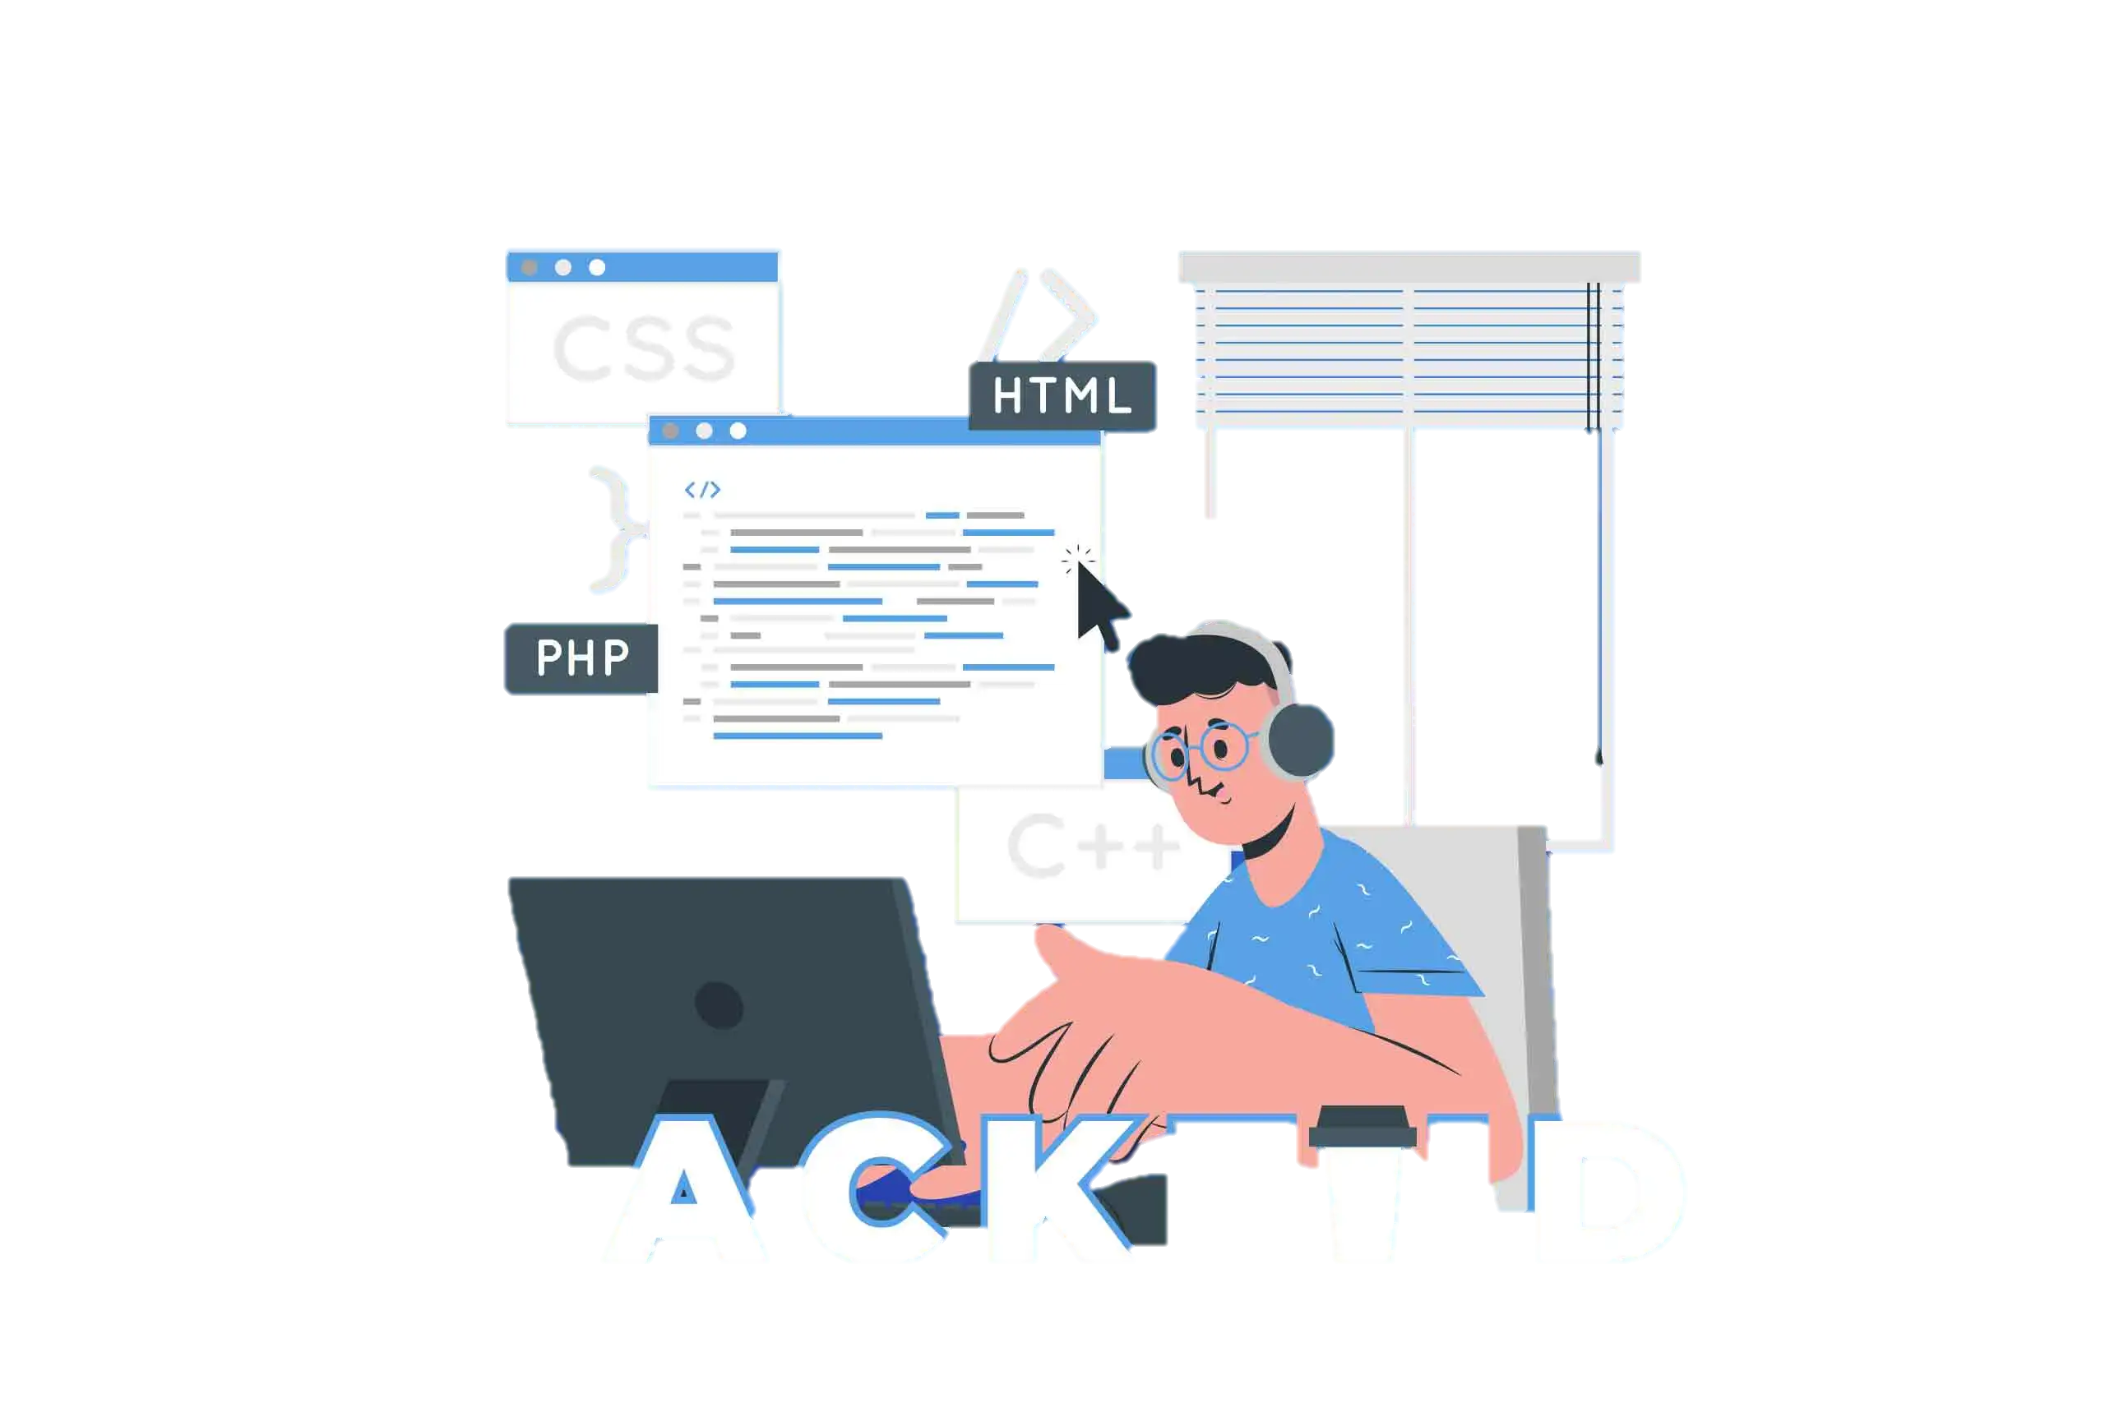
What is backend development
Backend development is the part of a website or app that users don’t see. It’s like the “behind the scenes” work that makes everything function properly.
like Node.js, Python, Java, Ruby, and databases such as MySQL, PostgreSQL, and MongoDB.

Slide 3
python Past
1990s – Python introduced by Guido van Rossum.
Early backend work used CGI scripts for web servers.
Limited frameworks, slower performance.
Mainly used for prototyping and scripting.

Slide 4
python Growth (2000s–2010s)
Rise of web frameworks like Django (2005) and Flask (2010).
Adoption in startups and enterprises for backend systems.
Integration with databases (MySQL, PostgreSQL, SQLite).
Popular for REST APIs, CMS, and e-commerce.

Slide 5
python Present
Widely used in backend web development.
Modern frameworks: FastAPI, Django, Flask.
Used for microservices, APIs, and cloud-native apps.
Integration with AI/ML, IoT, and Data Science.
Supported by cloud platforms (AWS, Azure, GCP).

Slide 6
python Future
AI-powered backends (chatbots, recommendation engines).
Growth of asynchronous frameworks (FastAPI, aiohttp).
Strong role in serverless computing and edge computing.
Enhanced performance with PyPy, Cython, Rust + Python integration.
Continued dominance in data + backend hybrid applications.

Slide 7
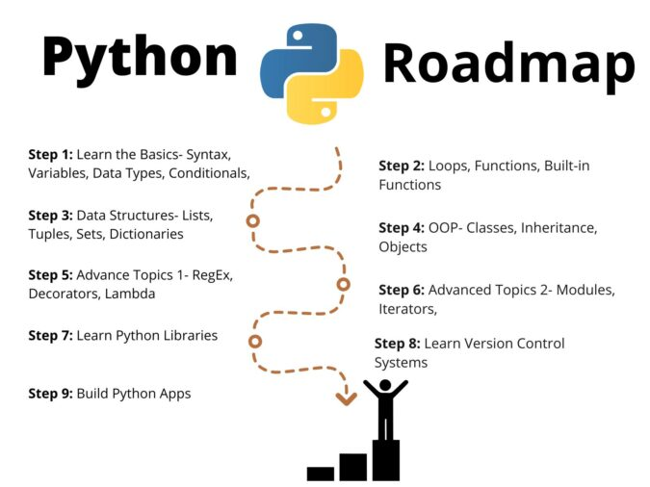

Slide 8
Thank you

